Slide 1

High-Level Design
Team 7- Service Charge App
Version No: 1.0 Updated By: Lj Vincent Tudtud
Approved By:

Slide 2
Revision History
Rev No. | MODIFIED BY | MODIFIED DATE | REMARKS | PRELIMINARY REVIEW AND APPROVAL | DATE REVIEWED | FINAL REVIEW AND APPROVAL | DATE APPROVED
1.0 | Tudtud, Lj Vincent | 2023/02/04 | Initial Creation | Last Name, First Name | yyyy/mm/dd | Last Name, First Name | yyyy/mm/dd

Slide 3
Screen Details
Team - 7

Slide 4
Screen List
Screen | Description | Remarks
Landing Page
Sign In Page
Forgot Password Page
Dashboard
Create Ticket
Generate Conforme Slip
Update Ticket

Slide 5
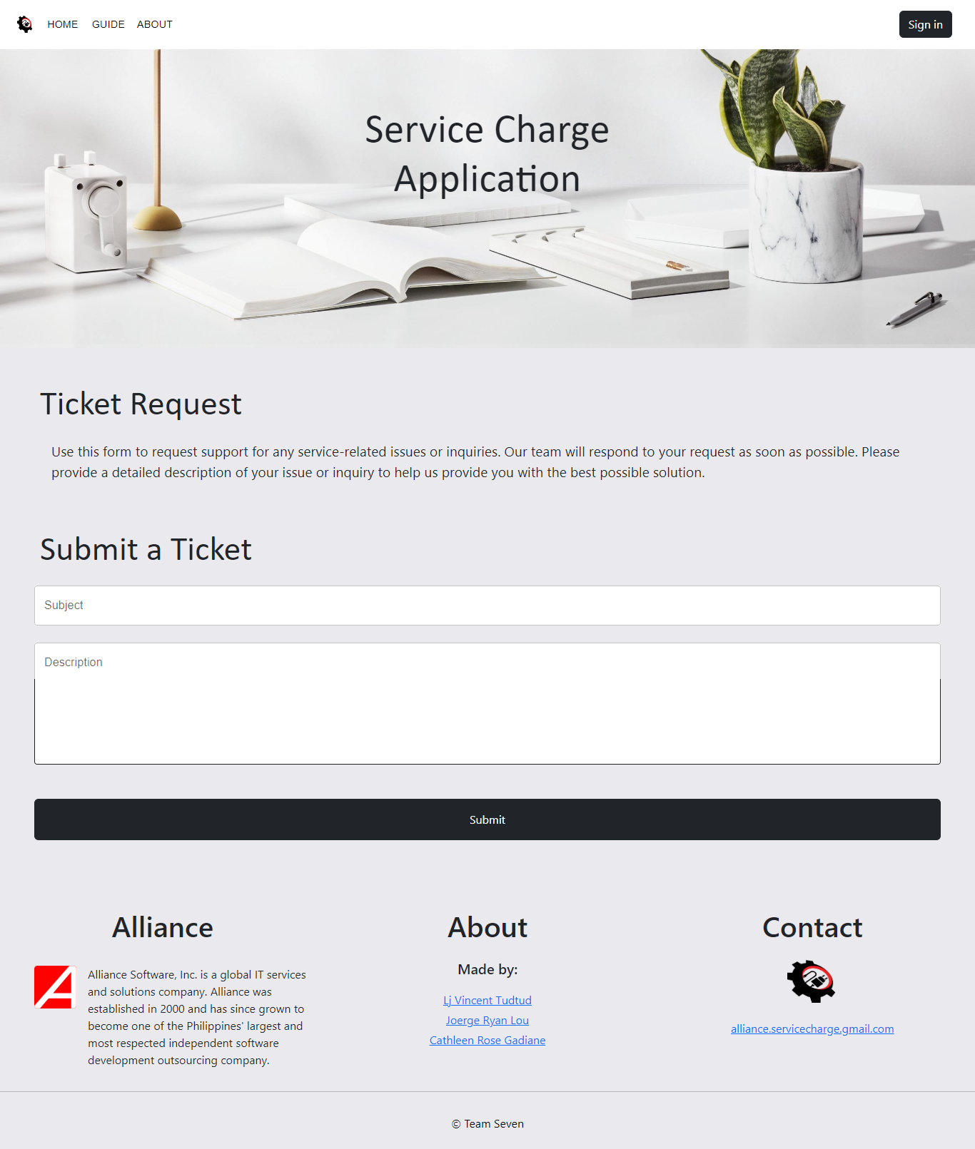
1.0 Landing Page

Slide 6
1.0 Landing Page
ITEMS | TYPE | REQUIRED? | DATA TYPE | SIZE | FORMAT
Sign In | Button | Yes | NA | NA | NA
Subject | Textbox | Yes | varchar | 255 | Text
Description | Textbox | Yes | varchar | 500 | Text
Submit | Button | Yes | NA | NA | NA
LOGIC
1.0 When the “Sign In” button is clicked, it will directly open a modal for Sign In.
2.0 Fill up the “Submit a Ticket” form 2.1 When ‘Submit” button is clicked, it will be directed to a Sign in since the user will need to sign in first.

Slide 7
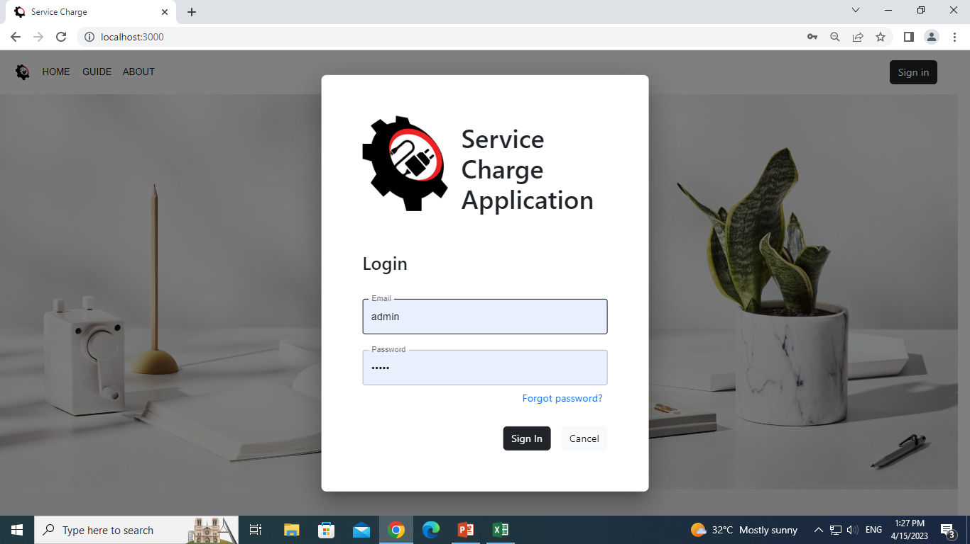
1.1 Sign In Page

Slide 8
1.1 Login Page
ITEMS | TYPE | REQUIRED? | DATA TYPE | SIZE | FORMAT
Email | Textbox | Yes | varchar | 255 | Text
Password | Textbox | Yes | varchar | 255 | Text
Forgot Password | Textlink | Yes | NA | NA | NA
Sign In | Button | Yes | NA | NA | NA
Cancel | Button | Yes | NA | NA | NA
LOGIC
1.0 When the “Sign In” button is clicked, it will go to the Dashboard page.
2.0 When the “Forgot Password” link is clicked, it will go to the Forgot Password page.

Slide 9
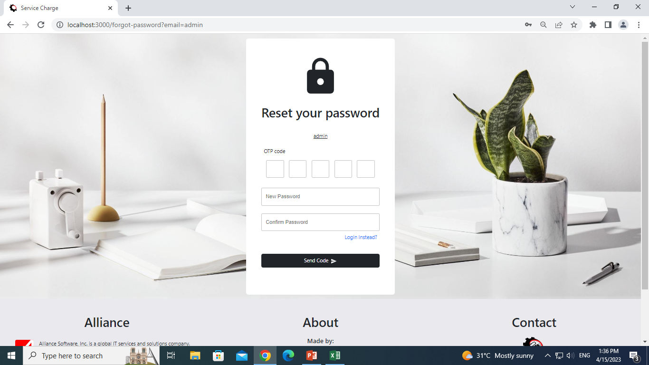
1.2 Forgot Password Page

Slide 10
1.2 Forgot Password
ITEMS | TYPE | REQUIRED? | DATA TYPE | SIZE | FORMAT
OTP Code | Textbox | Yes | varchar | 255 | Text
New Password | Textbox | Yes | varchar | 255 | Text
Confirm Password | Textbox | Yes | varchar | 255 | NA
Send Code | Button | Yes | NA | NA | NA
Login instead | Textlink | Yes | NA | NA | NA
LOGIC
1.0 When the “Send Code” button is clicked, it will go.
2.0 When the “Forgot Password” link is clicked, it will go to the Forgot Password page.

Slide 11
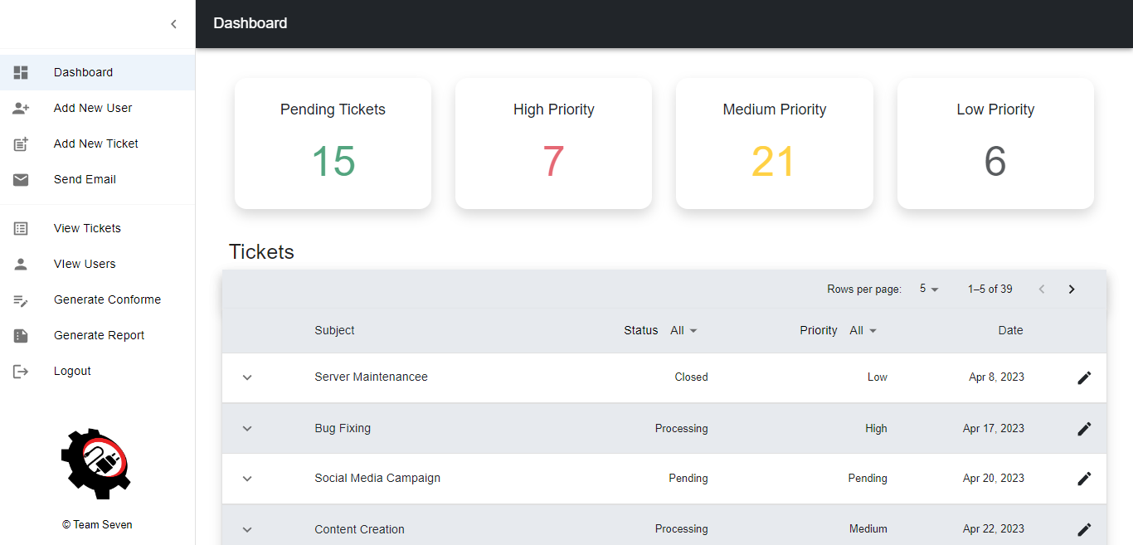
2.0 Dashboard

Slide 12
2.0 Dashboard
ITEMS | TYPE | REQUIRED? | DATA TYPE | SIZE | FORMAT
Pending Tickets | Button | Yes | NA | NA | NA
High Priority | Button | Yes | NA | NA | NA
Medium Priority | Button | Yes | NA | NA | NA
Low Priority | Button | Yes | NA | NA | NA
LOGIC
1.0 When the “Pending Tickets” button is clicked, the table will display all the pending tickets.
2.0 When the “High Priority” button is clicked, the table will display all the high priority tickets.
3.0 When the “Medium Priority” button is clicked, the table will display all the medium priority tickets.
4.0 When the “Low Priority” button is clicked, the table will display all the low priority tickets.

Slide 13
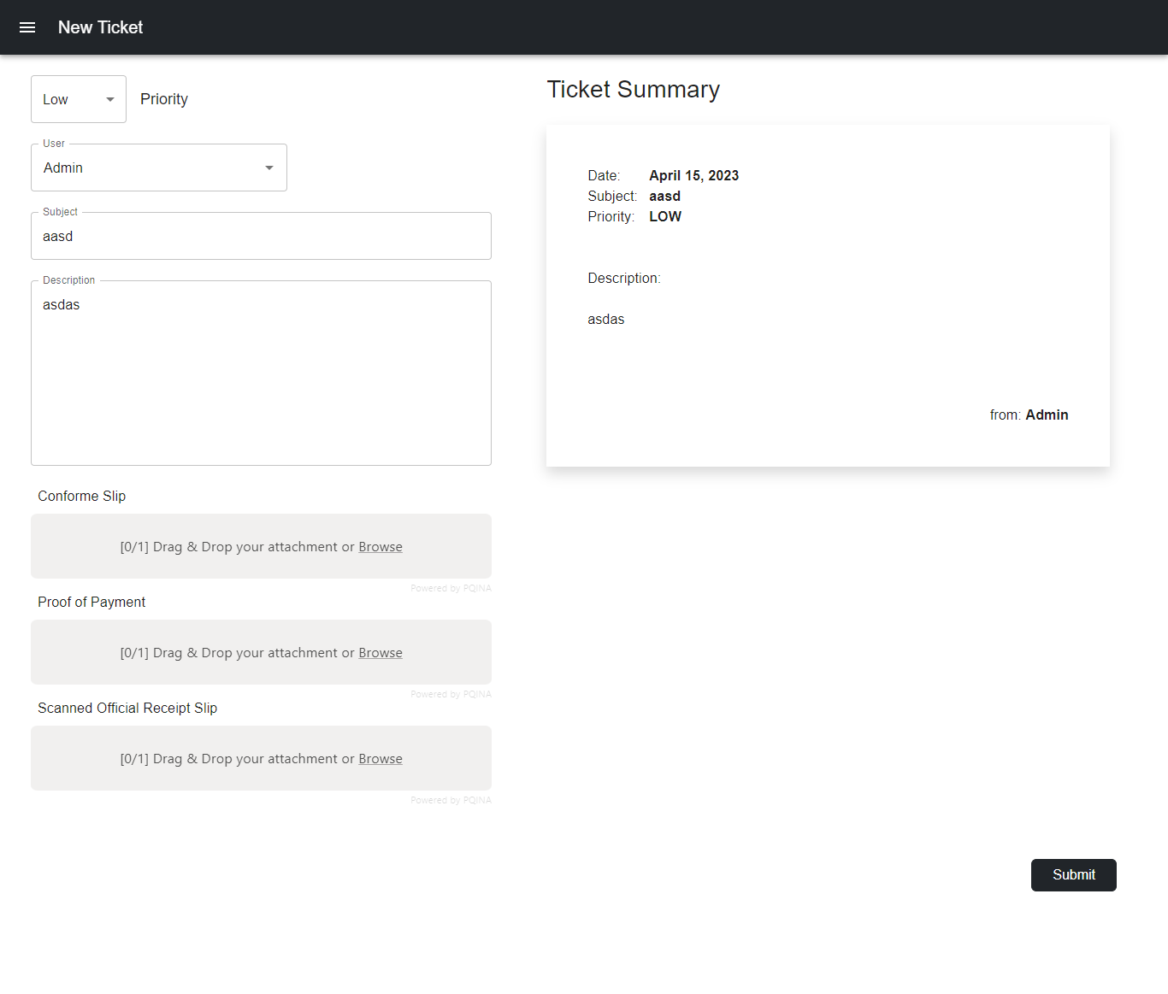
1.4 Create Ticket

Slide 14
2.0 Create Ticket
ITEMS | TYPE | REQUIRED? | DATA TYPE | SIZE | FORMAT
Priority | Dropdown | Yes | varchar | 255 | NA
User | Dropdown | Yes | varchar | 255 | NA
Subject | Textbox | Yes | varchar | 255 | Text
Description | Textbox | Yes | varchar | 500 | Text
Conforme Slip | File Upload | Yes | String | NA | NA
Proof of Payment | File Upload | Yes | String | NA | NA
Scanned Official Receipt Slip | File Upload | Yes | String | NA | NA
Submit | Button | Yes | NA | NA | NA
LOGIC
1.0 Fill in the Create Ticket form 1.1 If one of the required fields is empty, an error message displays.
2.0 When the “Submit” button, a confirmation will display and the ticket will be added to the table.

Slide 15
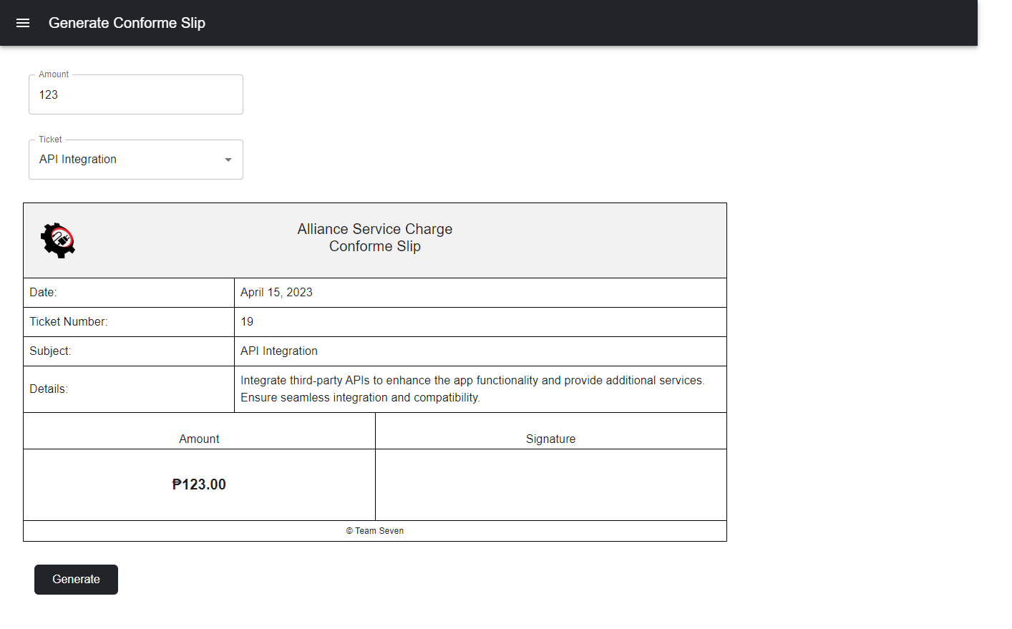
1.5 Generate Conforme Slip

Slide 16
2.0 Generate Conforme Slip
ITEMS | TYPE | REQUIRED? | DATA TYPE | SIZE | FORMAT
Amount | Textbox | Yes | int | NA | NA
Ticket | Dropdown | Yes | varchar | 255 | NA
Generate | Button | Yes | NA | NA | NA
LOGIC
1.0 After adding a value in the “Amount” field, it will display in the Generate Conforme Slip form.
2.0 When a value is selected in the “Ticket” dropdown, the details will be displayed in the Generate Conforme Slip form.
3.0 When the “Generate” button is clicked, an image will be generated and downloaded.

Slide 17
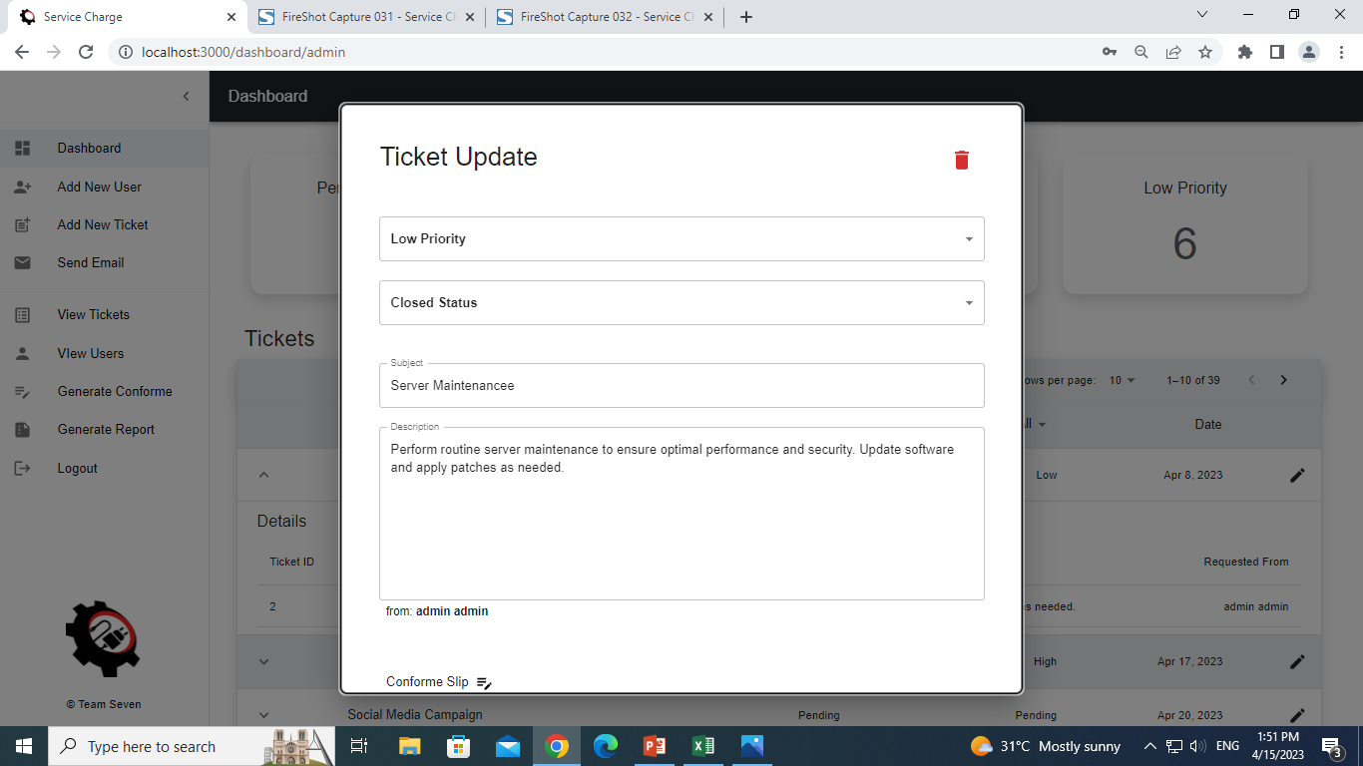
1.5 Update Ticket

Slide 18
2.0 Update Ticket
ITEMS | TYPE | REQUIRED? | DATA TYPE | SIZE | FORMAT
Priority | Textbox | Yes | int | NA | NA
Status | Dropdown | Yes | varchar | 255 | NA
Subject | Textbox | Yes | varchar | 255 | Text
Description | Textbox | Yes | varchar | 500 | Text
Conforme Slip | File Upload | Yes | String | NA | NA
Proof of Payment | File Upload | Yes | String | NA | NA
Scanned Official Receipt Slip | File Upload | Yes | String | NA | NA
Save | Button | Yes | NA | NA | NA
Cancel | Button | Yes | NA | NA | NA
Delete | Button | Yes | NA | NA | NA
LOGIC
1.0 When the “Save” button is clicked, the value/s will be updated and a confirmation will display.
2.0 When the “Delete” button is clicked, the data will be deleted and a confirmation will display.

Slide 19
1.1 Register Logic

Slide 20
1.2 Forgot Password Logic

Slide 21
1.2.1 Reset Password Logic

Slide 22
1.3 Main Page

Slide 23
1.3 Main Page Logic

Slide 24
1.4 Profile Logic

